Slide 1
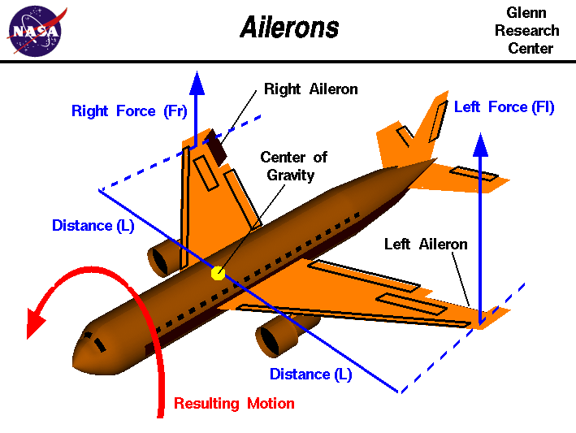
Ailerons
Michael Ayedun
Erik Carrion
https://github.com/itikn/9890_Project

Slide 2
Data Description
Goal: Predict the control action of the aircraft’s ailerons - reverse engineer human control skills to serve as a model for an auto-pilot system
Data Set:
- 13,750 observations
- 40 Predictors – represent the state of the aircraft
- No missing values
- No categorical variables

Slide 3
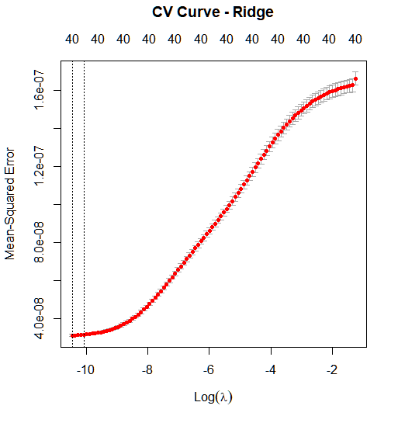
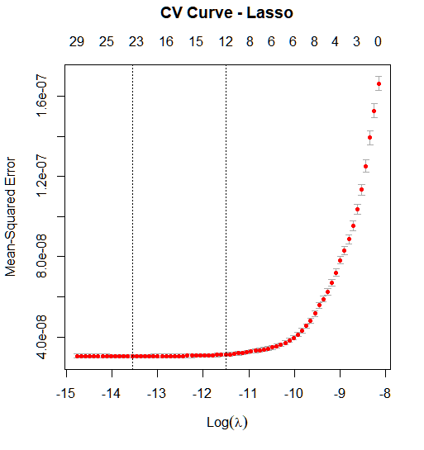
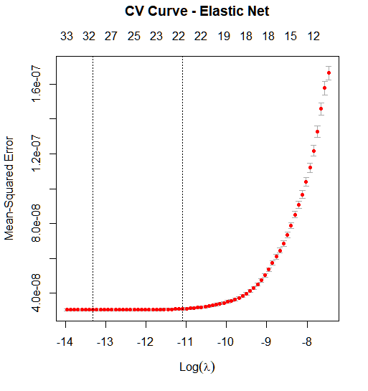
Cross Validation Curves
Run Time: .406 seconds
Run Time: .343 seconds
Run Time: .317 seconds

Slide 4
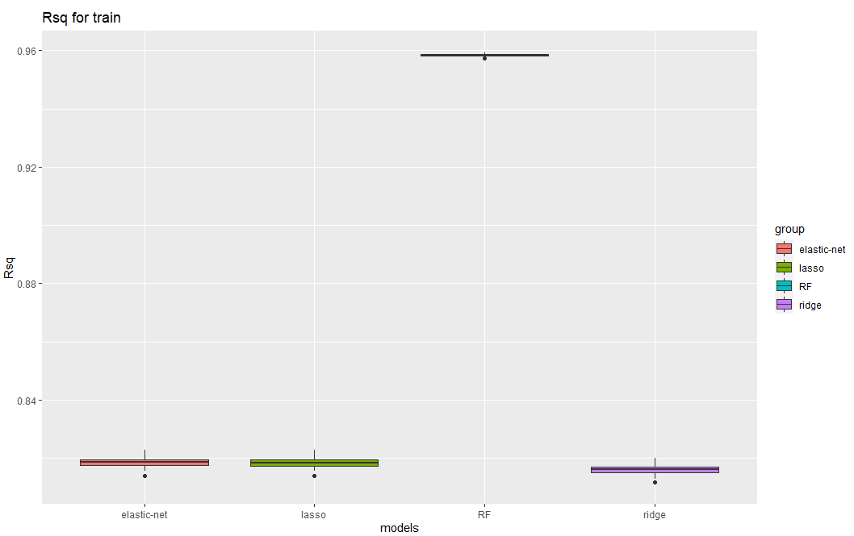
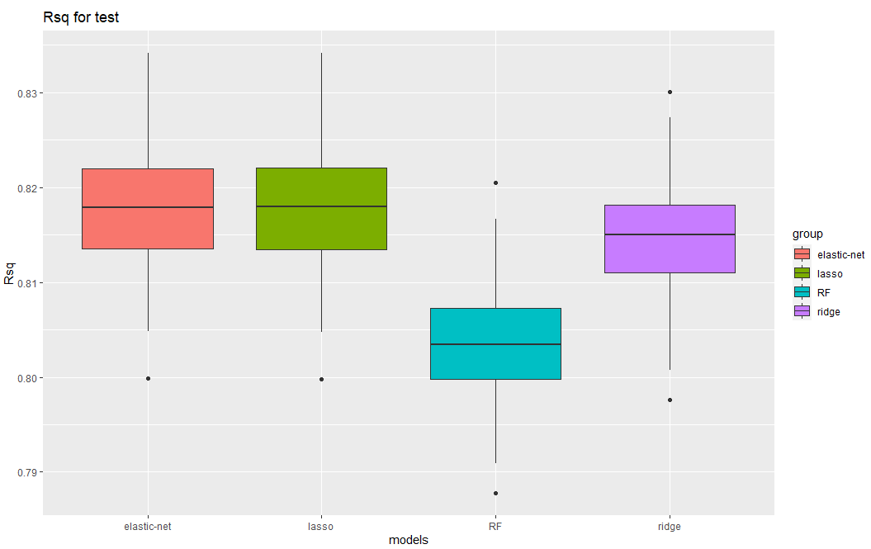
R² Boxplots for Training and Test Data

Slide 5
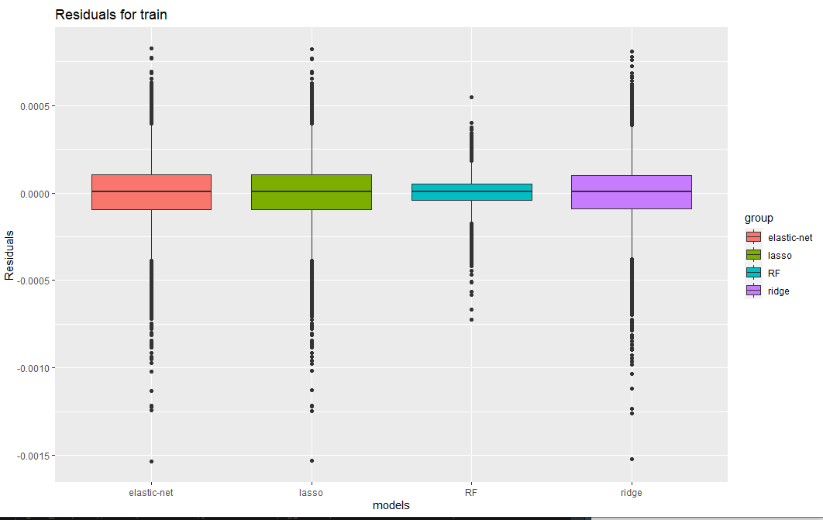
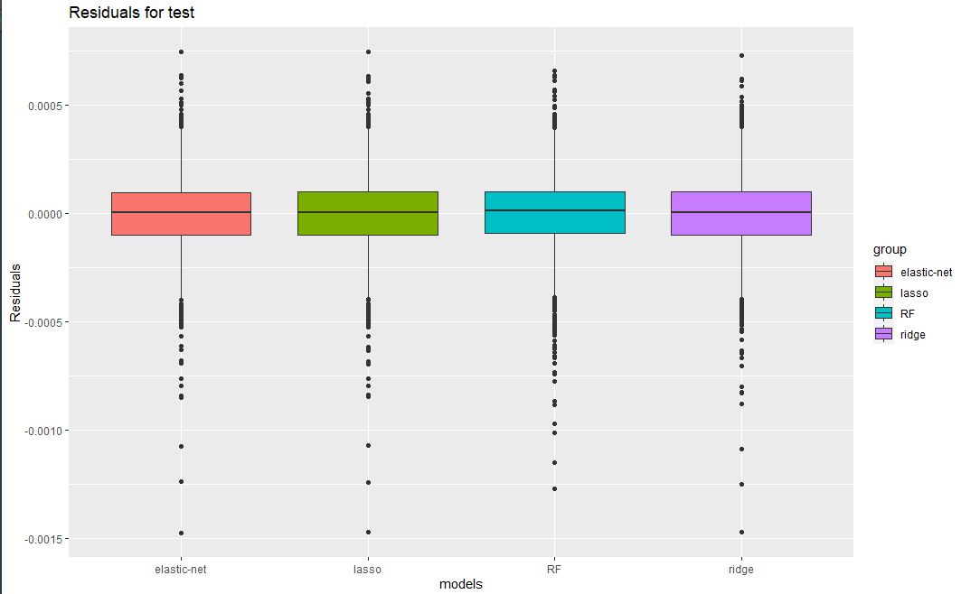
Residual Boxplots for Training and Test Data

Slide 6
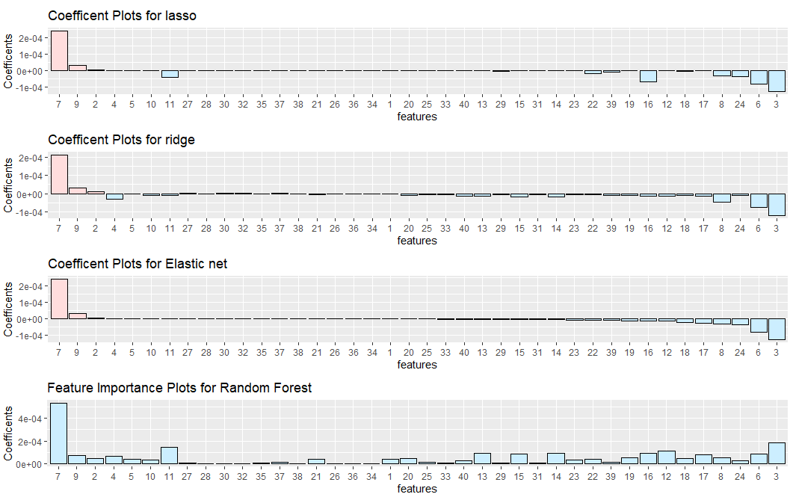
Important Variables
7, 3, & 6 : absRoll, p, curRoll
No Dictionary – Interpretation Difficult

Slide 7
Accuracy vs. Run Time
Method | 90% R² Interval | Full Fit Time
Ridge | .8066 - .8220 | 0.42
Lasso | .8096 - .8254 | 0.33
Elastic Net | .8096 - .8255 | 0.35
Random Forest | .7950 - .8160 | 116.98

Slide 8
Concluding Remarks
Random Forest – Tends to overfit, very slow. Multicollinearity an issue.
Lasso, Ridge, Elastic Net – Solid performance. Reduced Variance at the cost of added bias
Next Steps :
Refine the Ridge, Lasso, or Elastic Net Model.

